Slide 1
Probability EQ: What is the difference between theoretical and experimental probability?

Slide 2
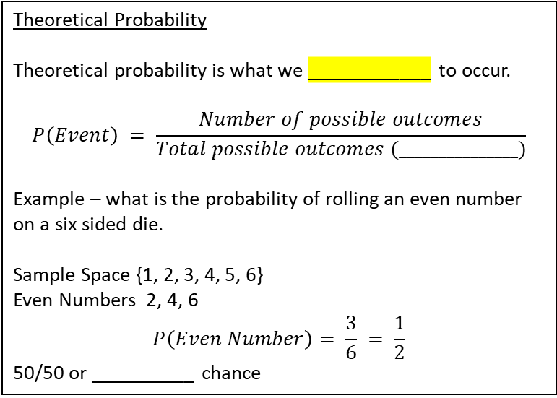
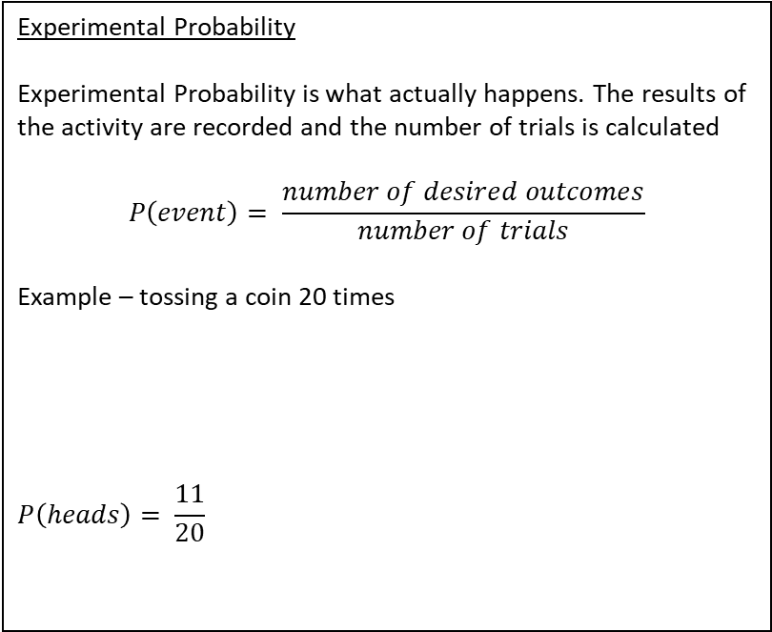
24
7
30
Probability
Date
EQ: What is the difference between theoretical and experimental probability?
What is theoretical probability?
Theoretical Probability
Theoretical probability is what we ____________ to occur.
$$P\left(Event\right) = \frac{Number of possible outcomes}{Total possible outcomes (_______________)}$$
Example – what is the probability of rolling an even number on a six sided die.
Sample Space {1, 2, 3, 4, 5, 6}
Even Numbers 2, 4, 6
$$P\left(Even Number\right)= \frac{3}{6} = \frac{1}{2}$$
50/50 or __________ chance
Experimental Probability
Experimental Probability is what actually happens. The results of the activity are recorded and the number of trials is calculated
$$P\left(event\right)= \frac{number of desired outcomes}{number of trials}$$
Example – tossing a coin 20 times
$$P\left(heads\right)= \frac{11}{20}$$
What is experimental probability?
Heads | Tails
11 | 9
Probability = Number of possible outcomes
Total number of outcomes

Slide 3
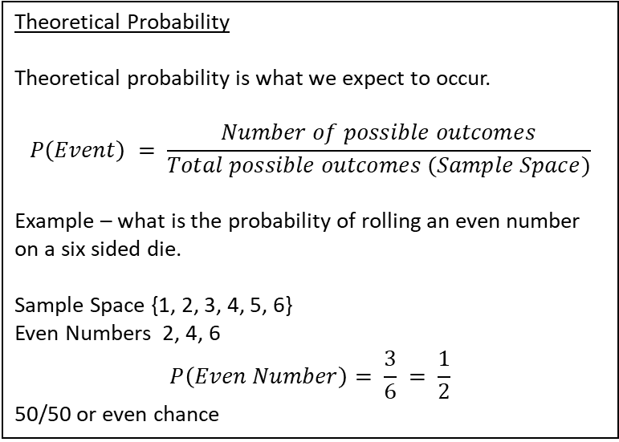
24
7
30
Probability
Date
EQ: What is the difference between theoretical and experimental probability?
What is theoretical probability?
Theoretical Probability
Theoretical probability is what we expect to occur.
$$P\left(Event\right) = \frac{Number of possible outcomes}{Total possible outcomes (Sample Space)}$$
Example – what is the probability of rolling an even number on a six sided die.
Sample Space {1, 2, 3, 4, 5, 6}
Even Numbers 2, 4, 6
$$P\left(Even Number\right)= \frac{3}{6} = \frac{1}{2}$$
50/50 or even chance
Experimental Probability
Experimental Probability is what actually happens. The results of the activity are recorded and the number of trials is calculated
$$P\left(event\right)= \frac{number of desired outcomes}{number of trials}$$
Example – tossing a coin 20 times
$$P\left(heads\right)= \frac{11}{20}$$
What is experimental probability?
Heads | Tails
11 | 9
Probability = Number of possible outcomes
Total number of outcomes

Slide 4
Practice:
2. Theoretical vs Experimental Probability worksheet – need a coin
2. One in every six experimental and theoretical probability

